Slide 1
String Processing

Slide 2

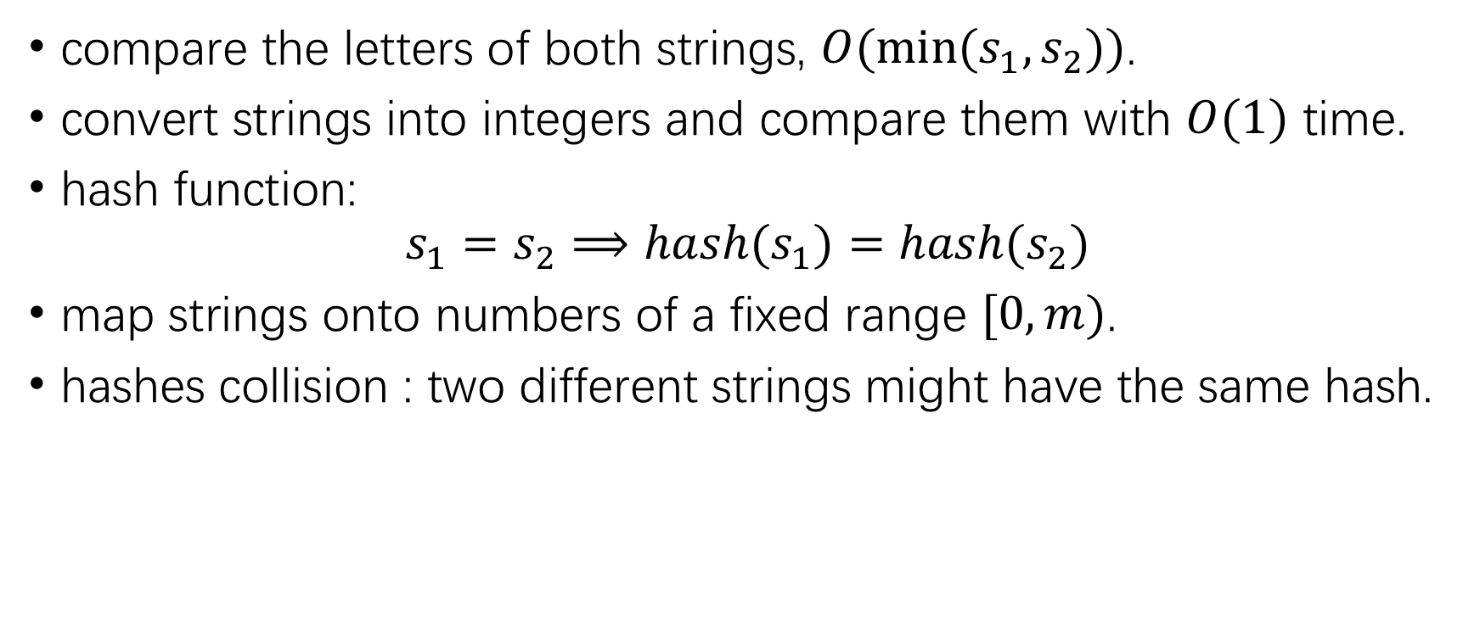
compare strings
compare the letters of both strings, $O(min⁡(s_{1},s_{2}))$.
convert strings into integers and compare them with $O(1)$ time.
hash function:
$$s_{1}=s_{2}⟹hash(s_{1})=hash(s_{2})$$
map strings onto numbers of a fixed range $[0,m)$.
hashes collision : two different strings might have the same hash.

Slide 3
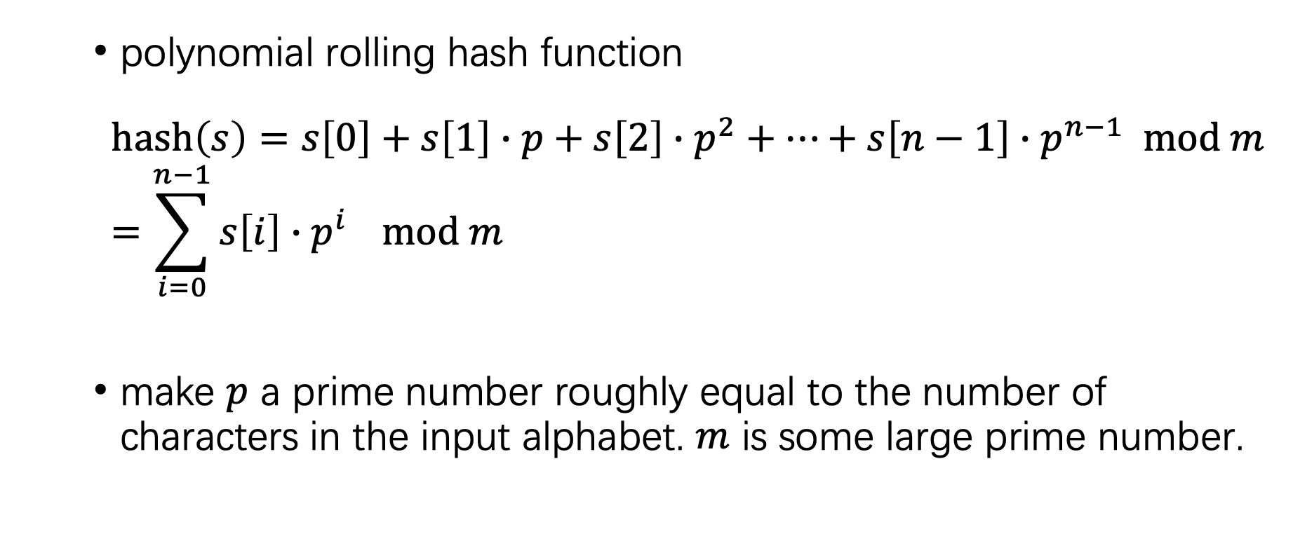
Calculation of the hash of a string
polynomial rolling hash function
$$hash\left(s\right)=s\left[0\right]+s\left[1\right]∙p+s\left[2\right]∙p^{2}+…+s\left[n−1\right]∙p^{n−1} mod m=\sum_{i=0}^{n−1}{s\left[i\right]∙p^{i}} mod m$$
make $p$ a prime number roughly equal to the number of characters in the input alphabet. $m$ is some large prime number.

Slide 4
Implementation of polynomial rolling hash
long long compute_hash(string const& s) {
const int p = 31;
const int m = 1e9 + 9;
long long hash_value = 0;
long long p_pow = 1;
for (char c : s) {
hash_value = (hash_value + (c - 'a' + 1) * p_pow) % m;
p_pow = (p_pow * p) % m;
}
return hash_value;
}

Slide 5
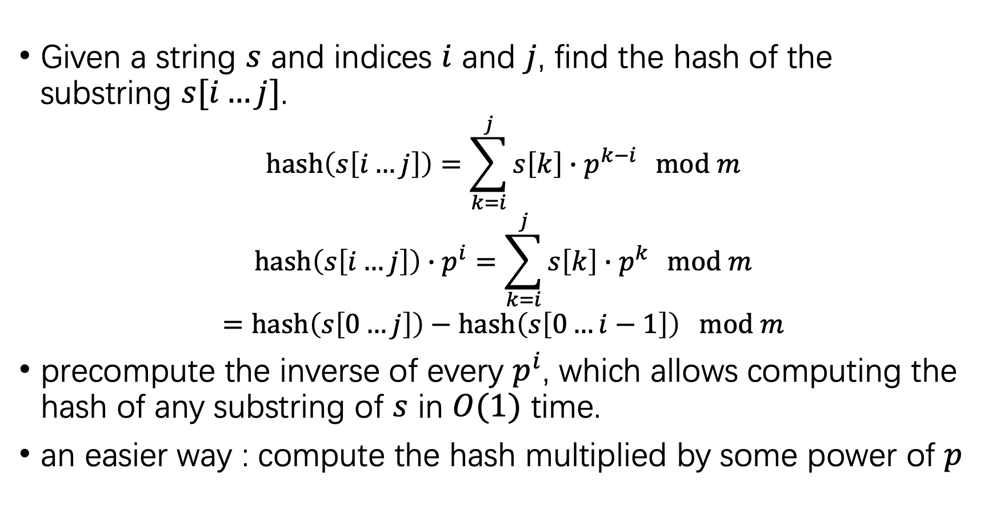
Fast hash calculation of substrings
Given a string $s$ and indices $i$ and $j$, find the hash of the substring $s[i…j]$.
$$hash\left(s\left[i…j\right]\right)=\sum_{k=i}^{j}{s\left[k\right]∙p^{k−i} } mod m$$
$$hash\left(s\left[i…j\right]\right)∙p^{i}=\sum_{k=i}^{j}{s\left[k\right]∙p^{k} } mod m$$
$$=hash\left(s\left[0…j\right]\right)−hash\left(s\left[0…i−1\right]\right) mod m$$
precompute the inverse of every $p^{i}$, which allows computing the hash of any substring of $s$ in $O(1)$ time.
an easier way : compute the hash multiplied by some power of $p$

Slide 6
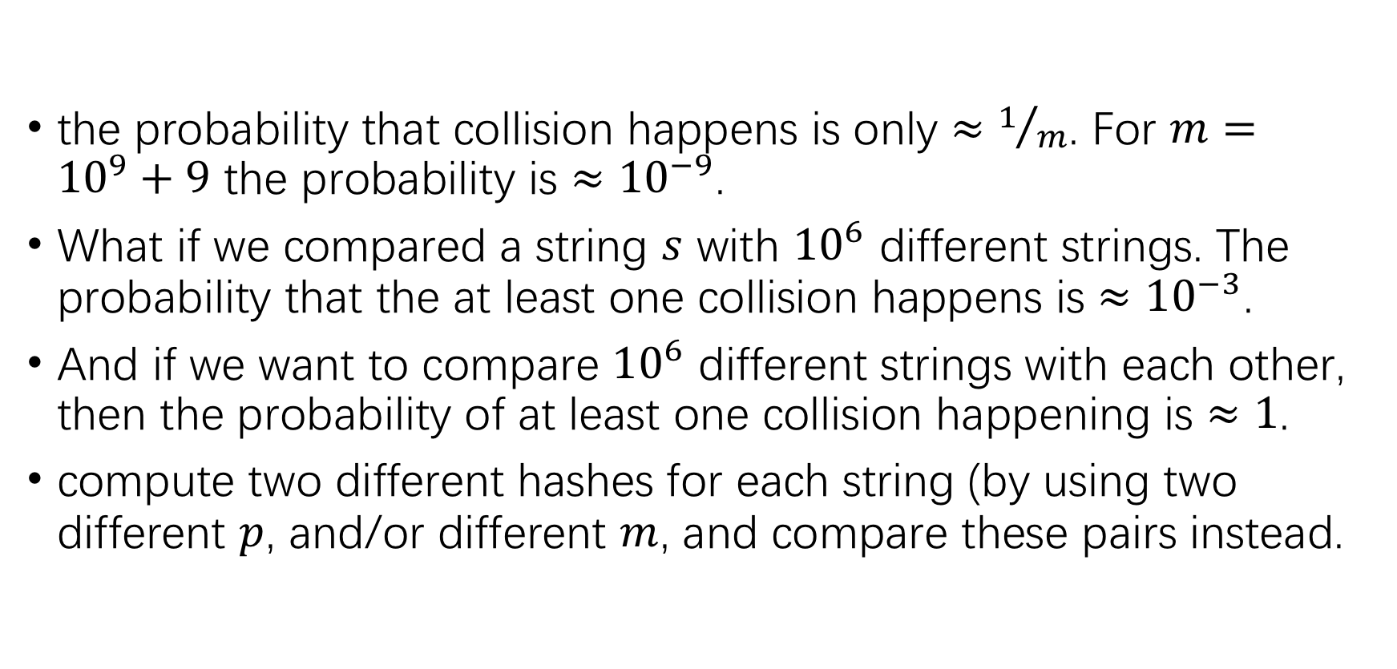
Improve no-collision probability
the probability that collision happens is only $≈1/m$. For $m={10}^{9}+9$ the probability is $≈{10}^{−9}$.
What if we compared a string $s$ with ${10}^{6}$ different strings. The probability that the at least one collision happens is $≈{10}^{−3}$.
And if we want to compare ${10}^{6}$ different strings with each other, then the probability of at least one collision happening is $≈1$.
compute two different hashes for each string (by using two different $p$, and/or different $m$, and compare these pairs instead.

Slide 7
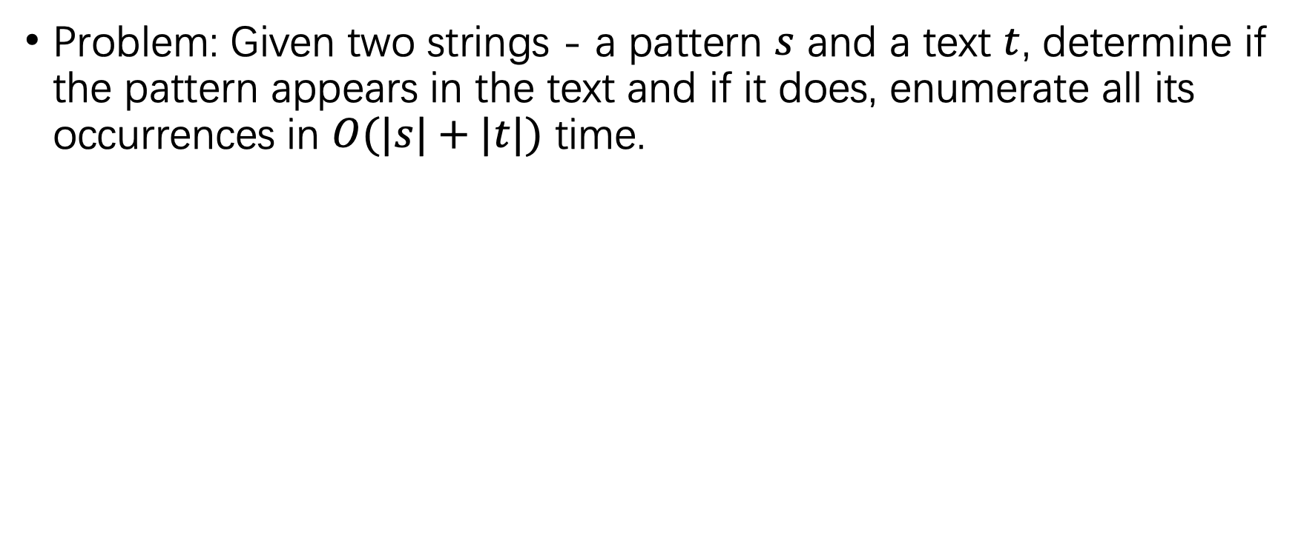
Rabin-Karp Algorithm for string matching
Problem: Given two strings - a pattern $s$ and a text $t$, determine if the pattern appears in the text and if it does, enumerate all its occurrences in $O(|s|+|t|)$ time.

Slide 8
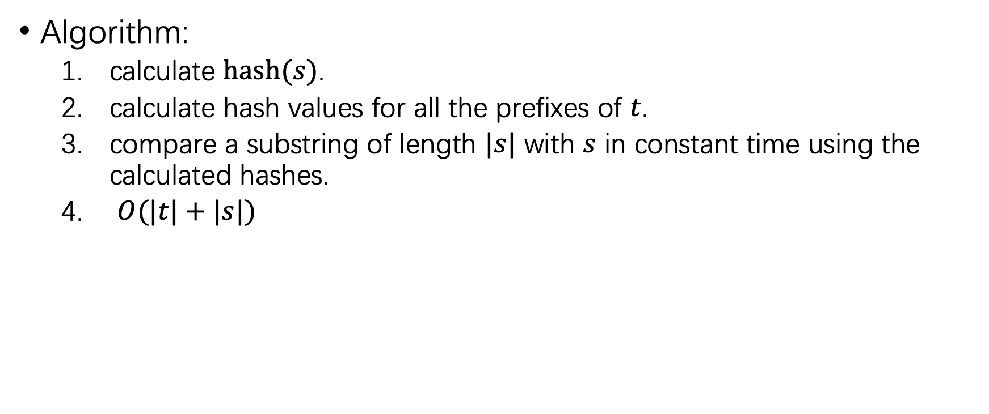
Rabin-Karp Algorithm for string matching
Algorithm:
calculate $hash(s)$.
calculate hash values for all the prefixes of $t$.
compare a substring of length $|s|$ with $s$ in constant time using the calculated hashes.
$O(|t|+|s|)$

Slide 9
Implementation of Rabin-Karp Algorithm
vector<int> rabin_karp(string const& s, string const& t) {
const int p = 31;
const int m = 1e9 + 9;
int S = s.size(), T = t.size();
vector<long long> p_pow(max(S, T));
p_pow[0] = 1;
for (int i = 1; i < (int)p_pow.size(); i++)
p_pow[i] = (p_pow[i-1] * p) % m;
vector<long long> h(T + 1, 0);
for (int i = 0; i < T; i++)
h[i+1] = (h[i] + (t[i] - 'a' + 1) * p_pow[i]) % m;
long long h_s = 0;
for (int i = 0; i < S; i++)
h_s = (h_s + (s[i] - 'a' + 1) * p_pow[i]) % m;

Slide 10
Implementation of Rabin-Karp Algorithm
vector<int> occurences;
for (int i = 0; i + S - 1 < T; i++) {
long long cur_h = (h[i+S] + m - h[i]) % m;
if (cur_h == h_s * p_pow[i] % m)
occurences.push_back(i);
}
return occurences;
}

Slide 11
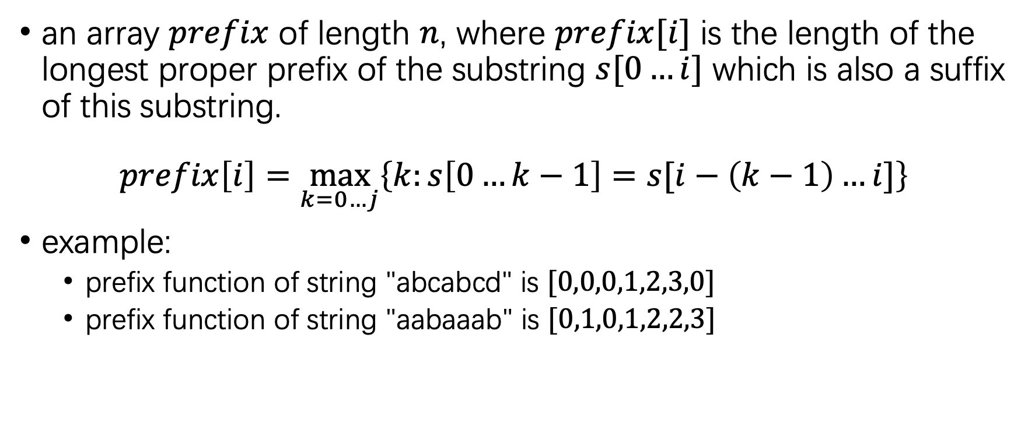
Prefix function
an array $prefix$ of length $n$, where $prefix[i]$ is the length of the longest proper prefix of the substring $s[0…i]$ which is also a suffix of this substring.
$$prefix\left[i\right]=\max_{k=0…j}\left\{k:s\left[0…k−1\right]=s[i−\left(k−1\right)…i]\right\}$$
example:
prefix function of string "abcabcd" is $[0,0,0,1,2,3,0]$
prefix function of string "aabaaab" is $[0,1,0,1,2,2,3]$

Slide 12
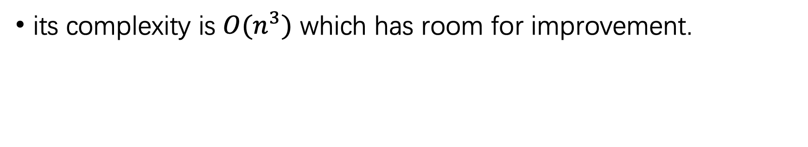
Trivial Algorithm
vector<int> prefix_function(string s) {
int n = (int)s.length();
vector<int> prefix(n);
for (int i = 0; i < n; i++)
for (int k = 0; k <= i; k++)
if (s.substr(0, k) == s.substr(i-k+1, k))
prefix[i] = k;
return prefix;
}
its complexity is $O(n^{3})$ which has room for improvement.

Slide 13
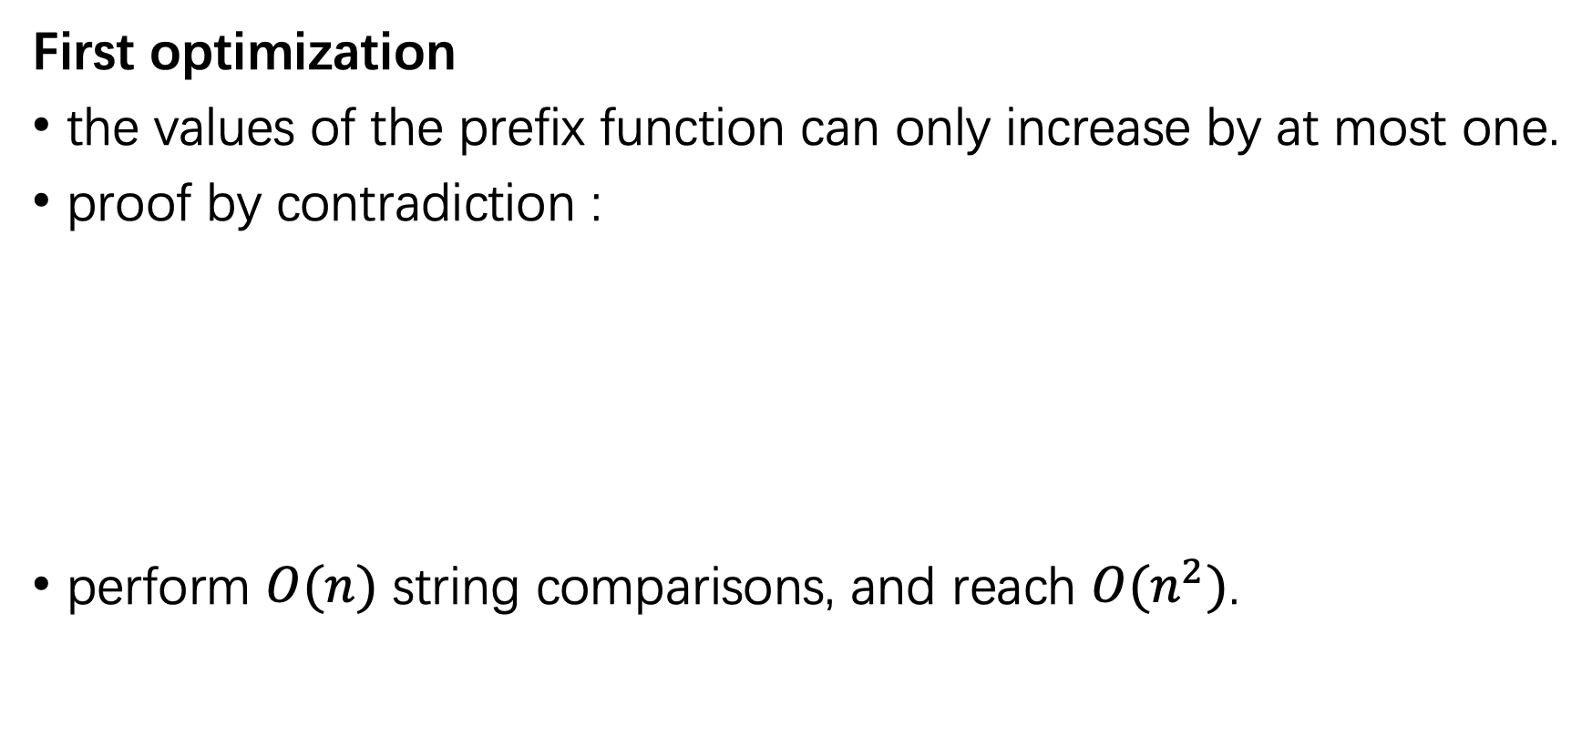
Efficient Algorithm
First optimization
the values of the prefix function can only increase by at most one.
proof by contradiction :
perform $O(n)$ string comparisons, and reach $O(n^{2})$.

Slide 14
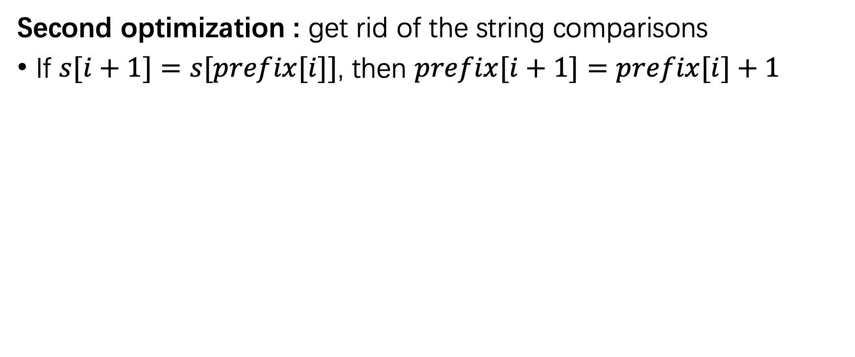
Efficient Algorithm
Second optimization : get rid of the string comparisons
If $s[i+1]=s[prefix[i]]$, then $prefix[i+1]=prefix[i]+1$

Slide 15
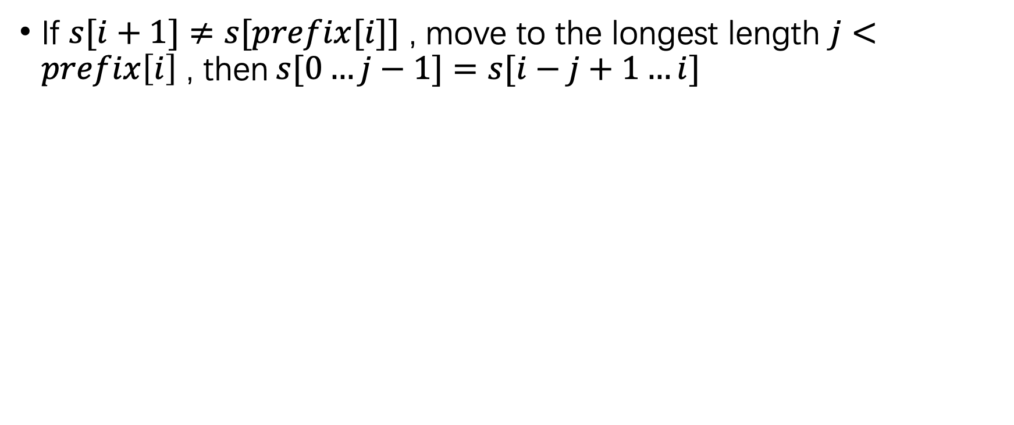
Efficient Algorithm
If $s[i+1]≠s[prefix[i]]$ , move to the longest length $j<prefix\left[i\right]$ , then$s[0…j−1]=s[i−j+1…i]$

Slide 16
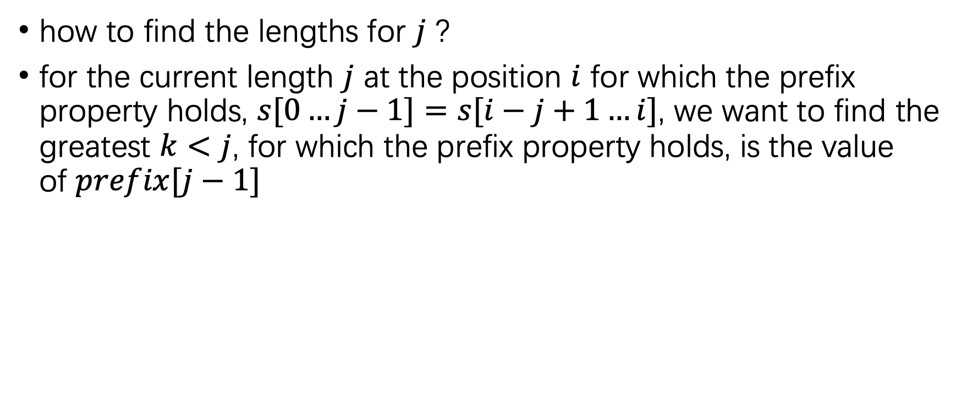
Efficient Algorithm
how to find the lengths for $j$ ?
for the current length $j$ at the position $i$ for which the prefix property holds, $s[0…j−1]=s[i−j+1…i]$, we want to find the greatest $k<j$, for which the prefix property holds, is the value of $prefix[j−1]$

Slide 17
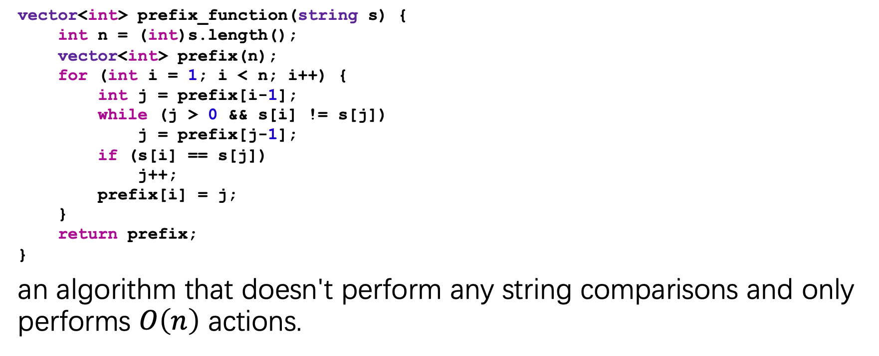
Implementation of efficient Algorithm
vector<int> prefix_function(string s) {
int n = (int)s.length();
vector<int> prefix(n);
for (int i = 1; i < n; i++) {
int j = prefix[i-1];
while (j > 0 && s[i] != s[j])
j = prefix[j-1];
if (s[i] == s[j])
j++;
prefix[i] = j;
}
return prefix;
}
an algorithm that doesn't perform any string comparisons and only performs $O\left(n\right)$ actions.

Slide 18
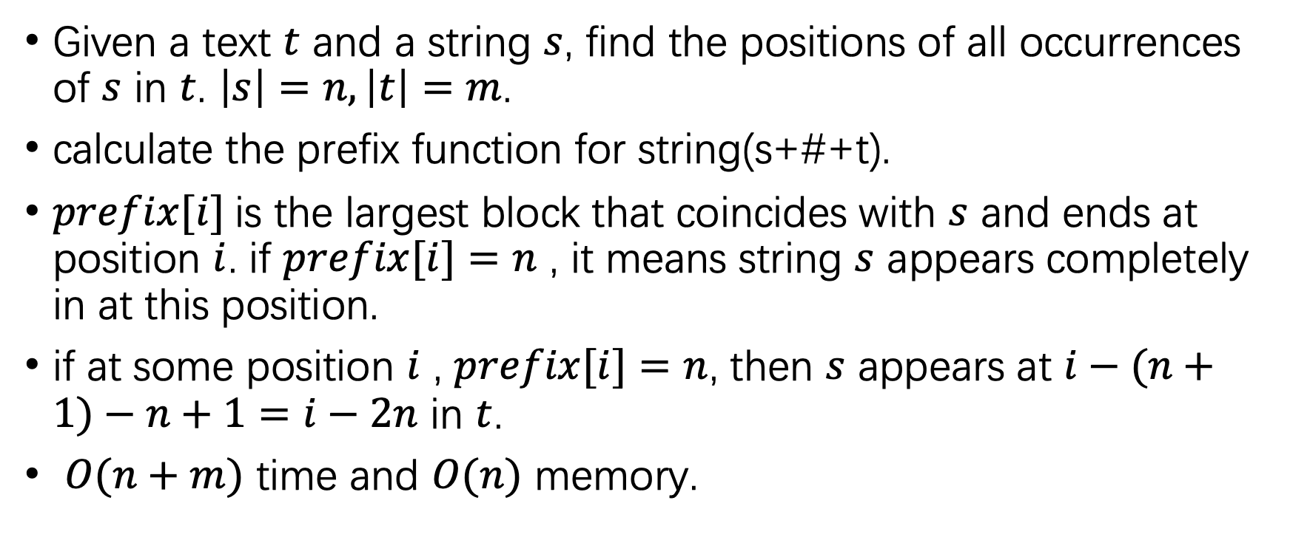
The Knuth-Morris-Pratt algorithm
Given a text $t$ and a string $s$, find the positions of all occurrences of $s$ in $t$. $\left|s\right|=n,\left|t\right|=m$.
calculate the prefix function for string(s+#+t).
$prefix[i]$is the largest block that coincides with $s$ and ends at position $i$. if $prefix[i]=n$ , it means string $s$ appears completely in at this position.
if at some position $i$ , $prefix[i]=n$, then $s$ appears at $i−(n+1)−n+1=i−2n$ in $t$.
$O(n+m)$ time and $O(n)$ memory.

Slide 19
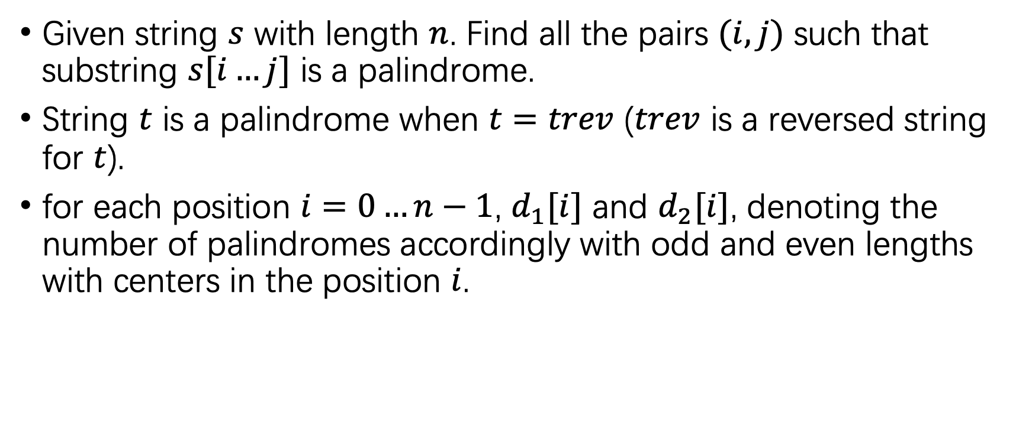
Finding all sub-palindromes
Given string $s$ with length $n$. Find all the pairs $(i,j)$ such that substring $s[i…j]$ is a palindrome.
String $t$ is a palindrome when $t=trev$ ($trev$ is a reversed string for $t$).
for each position $i=0…n−1$, $d_{1}[i]$ and $d_{2}[i]$, denoting the number of palindromes accordingly with odd and even lengths with centers in the position $i$.

Slide 20
Trivial algorithm
vector<int> d1(n), d2(n);
for (int i = 0; i < n; i++) {
d1[i] = 1;
while (0 <= i - d1[i] && i + d1[i] < n && s[i - d1[i]] == s[i + d1[i]]) {
d1[i]++;
}
d2[i] = 0;
while (0 <= i - d2[i] - 1 && i + d2[i] < n && s[i - d2[i] - 1] == s[i + d2[i]]) {
d2[i]++;
}
}

Slide 21
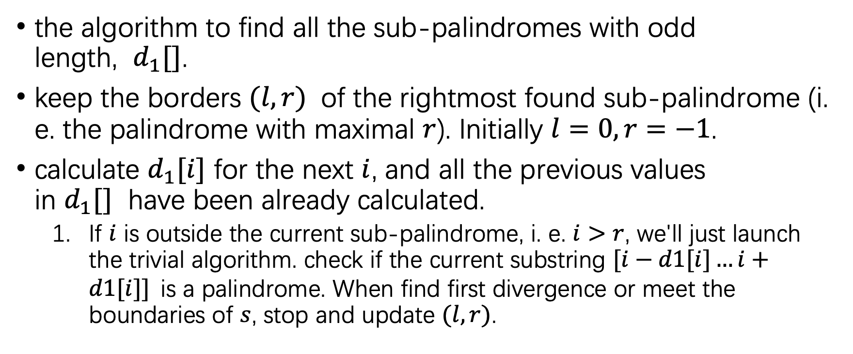
Manacher's algorithm
the algorithm to find all the sub-palindromes with odd length, $d_{1}[]$.
keep the borders $(l,r)$ of the rightmost found sub-palindrome (i. e. the palindrome with maximal $r$). Initially $l=0,r=−1$.
calculate $d_{1}[i]$ for the next $i$, and all the previous values in $d_{1}[]$ have been already calculated.
If $i$ is outside the current sub-palindrome, i. e. $i>r$, we'll just launch the trivial algorithm. check if the current substring $[i−d1[i]…i+d1[i]]$is a palindrome. When find first divergence or meet the boundaries of $s$, stop and update $(l,r)$.

Slide 22
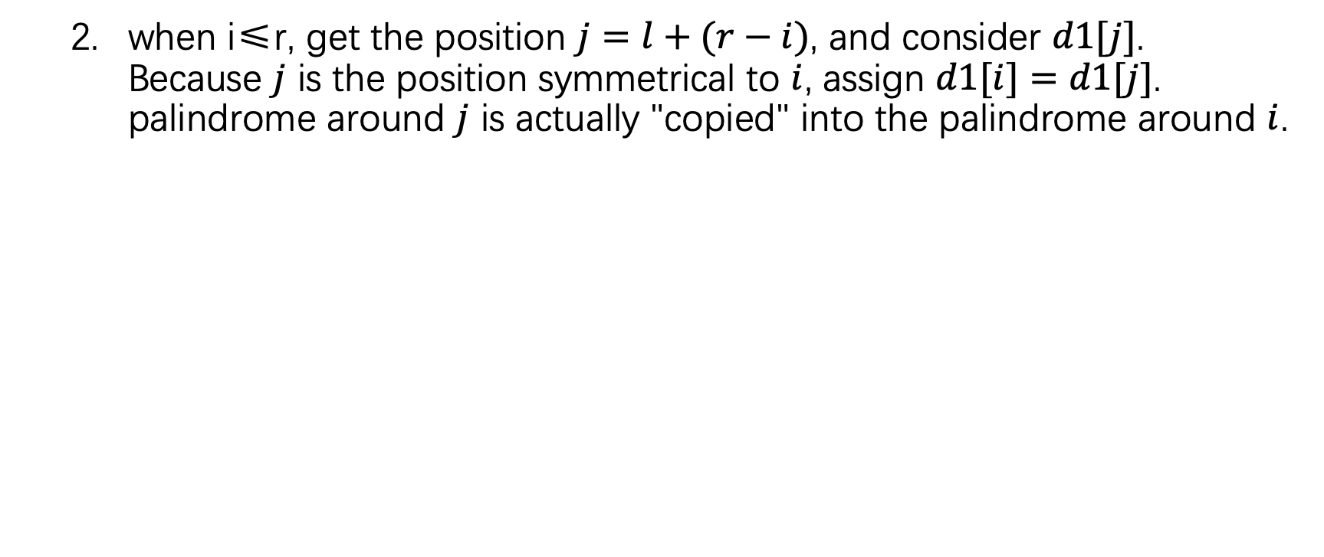
Manacher's algorithm
when i≤r, get the position $j=l+(r−i)$, and consider $d1[j]$. Because $j$ is the position symmetrical to $i$, assign $d1[i]=d1[j]$. palindrome around $j$ is actually "copied" into the palindrome around $i$.

Slide 23
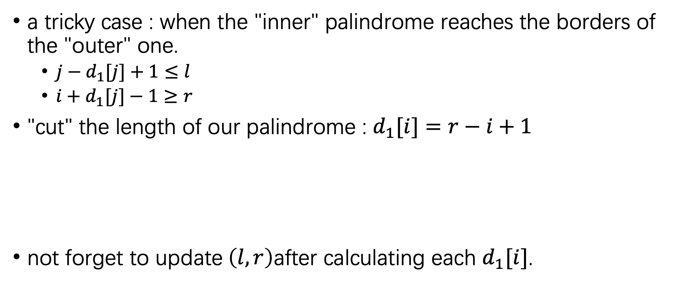
Manacher's algorithm
a tricky case : when the "inner" palindrome reaches the borders of the "outer" one.
$j−d_{1}[j]+1≤l$
$i+d_{1}[j]−1≥r$
"cut" the length of our palindrome : $d_{1}[i]=r−i+1$
not forget to update$\left(l,r\right)$after calculating each $d_{1}[i]$.

Slide 24
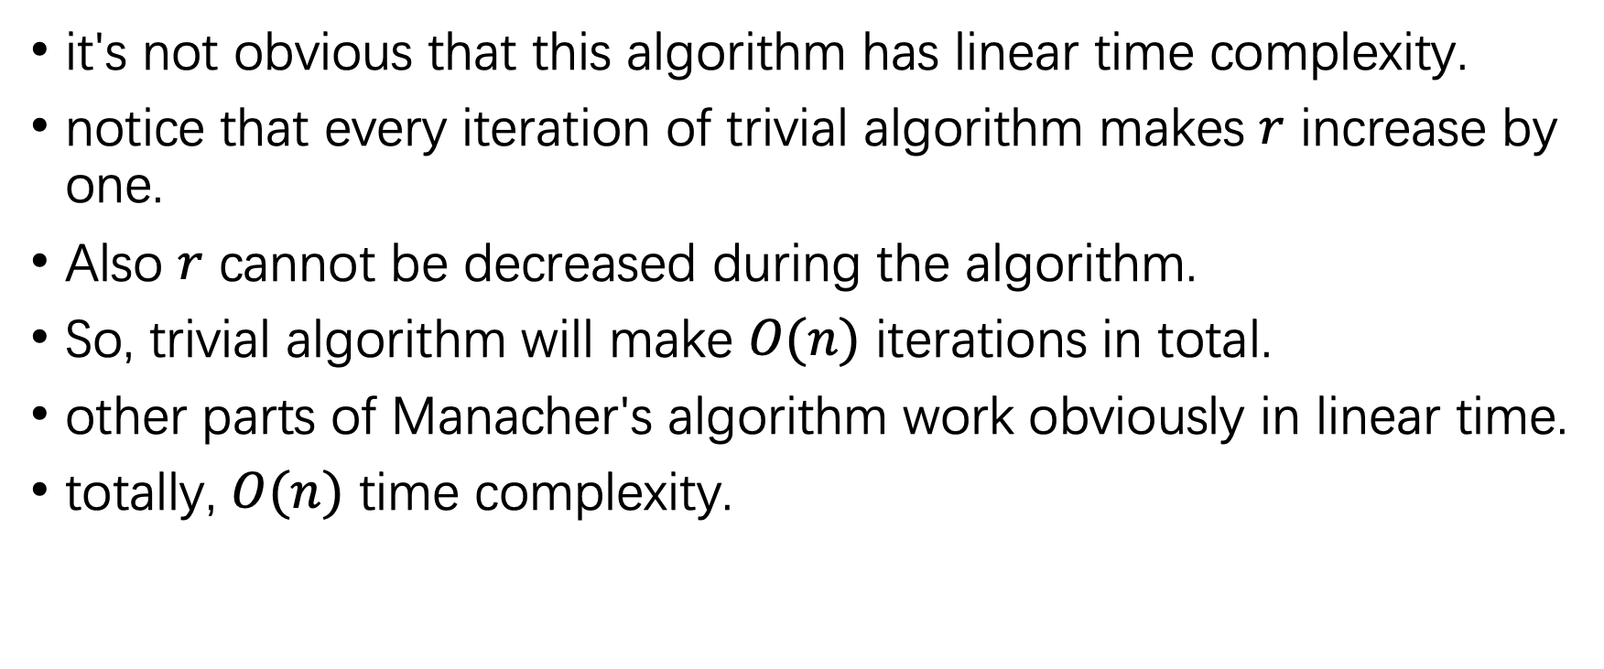
Complexity of Manacher's algorithm
it's not obvious that this algorithm has linear time complexity.
notice that every iteration of trivial algorithm makes $r$ increase by one.
Also $r$ cannot be decreased during the algorithm.
So, trivial algorithm will make $O(n)$ iterations in total.
other parts of Manacher's algorithm work obviously in linear time.
totally, $O(n)$ time complexity.

Slide 25
Implementation of Manacher's algorithm
vector<int> d1(n);
for (int i = 0, l = 0, r = -1; i < n; i++) {
int k = (i > r) ? 1 : min(d1[l + r - i], r - i + 1);
while (0 <= i - k && i + k < n && s[i - k] == s[i + k]) {
k++;
}
d1[i] = k--;
if (i + k > r) {
l = i - k;
r = i + k;
}
}

Slide 26
Implementation of Manacher's algorithm
vector<int> d2(n);
for (int i = 0, l = 0, r = -1; i < n; i++) {
int k = (i > r) ? 0 : min(d2[l + r - i + 1], r - i + 1);
while (0 <= i - k - 1 && i + k < n && s[i - k - 1] == s[i + k]) {
k++;
}
d2[i] = k--;
if (i + k > r) {
l = i - k - 1;
r = i + k ;
}
}

Slide 27
The End

